Slide 1
DeepFM:
A Factorization-Machine based Neural Network for CTR Prediction
Huifeng Guo, Ruiming Tang, Yunming Ye, Zhenguo Li, Xiuqiang He,Shenzhen Graduate School, Harbin Institute of Technology, China, Noah’s Ark Research Lab, Huawei, China
Group Number: 47
Group Members: 蘇桓平 P76071462

Slide 2
Motivation
Learning sophisticated feature interactions behind user behaviors is critical in maximizing CTR for recommender systems
Existing methods seem to have a strong bias towards low- or high-order interactions, or require expertise feature engineering
Online advertising is important to improve revenue

Slide 3
Objective
end-to-end learning model that emphasizes both low and high order feature interactions
combines factorization machines (FM) and deep neural network (DNN)
Reduce training time
Improve advertise click through rate
Learn implicit feature interactions behind user click behaviors

Slide 4
Contribution
DeepFM introduce FM and DNN, use both strength to learn both low-order and high-order data
FM run faster than LR, and able to estimate parameters under huge sparsity
DNN can learn 3 or more feature interaction in data

Slide 5
System Framework: Training Process
Download dataset from Criteo dataset
Use first 1M data for training
60% for training, 20% for validating, 20% for testing
For numerical features,normalzied to continous values
For categorical features, removed long-tailed data appearing less than 200 times.
Feature embedding
Feed data to FM & DNN to input
Train FM & DNN
Sigmod(FM + DNN output)

Slide 6
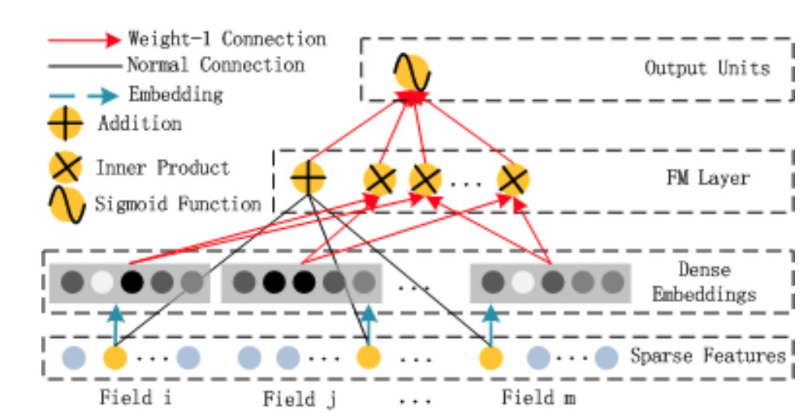
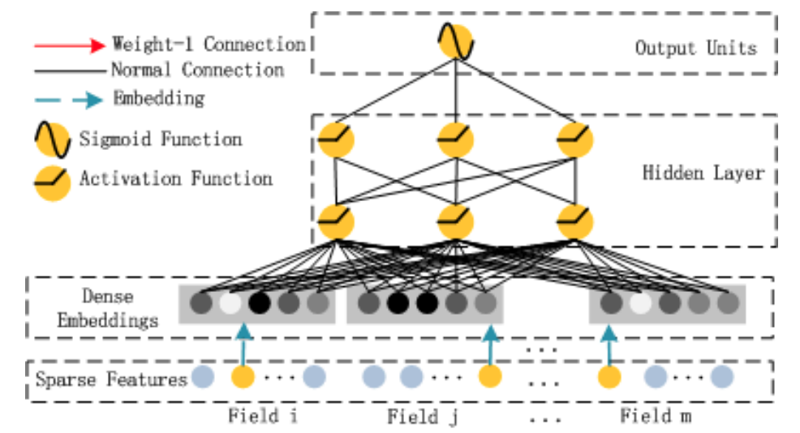
Deep Learning Architecture
FM
DNN

Slide 7
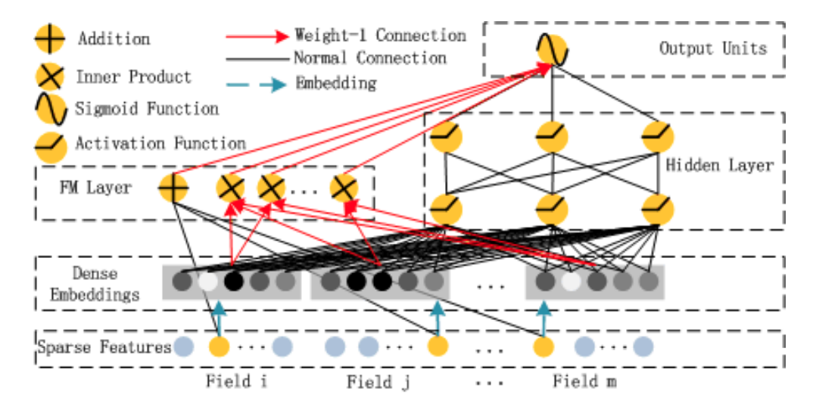


Slide 8

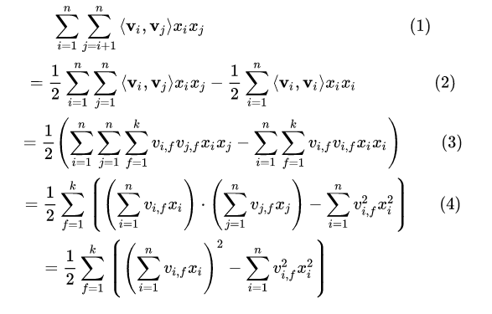


1. DNN
2. FM
3. sigmod

Slide 9
Experimental Result
 | AUC | LogLoss | Times(s)
DeepFM | 0.7396 | 0.5563 | 2987.3961
FNN | 0.7347 | 0.5617 | 3286.9882
WDL | 0.7419 | 0.5377 | 2991.12163
NFM | 0.7407 | 0.537 | 3100.4507

Slide 10
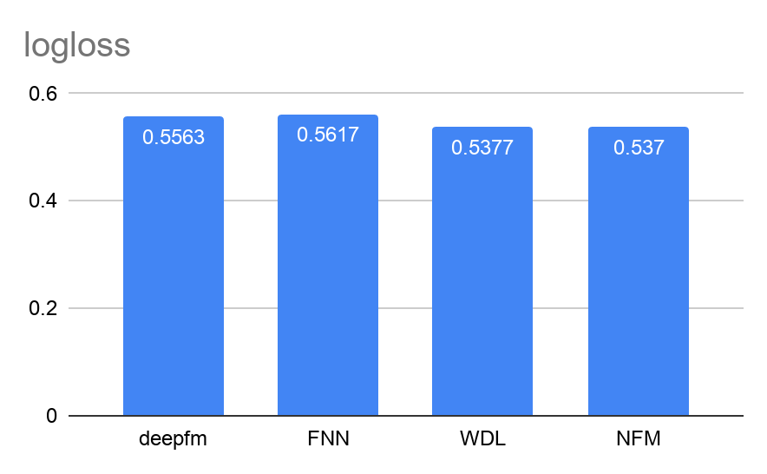
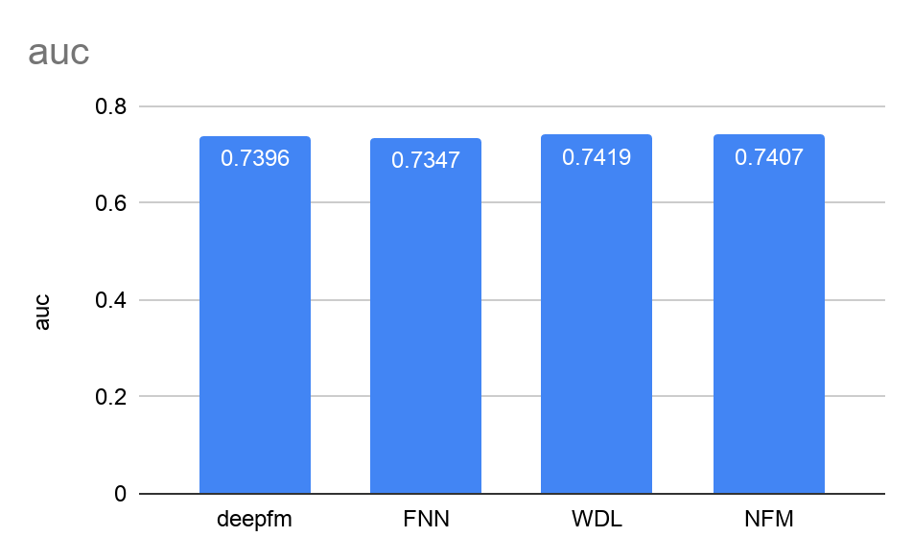
Logloss vs AUC

Slide 11
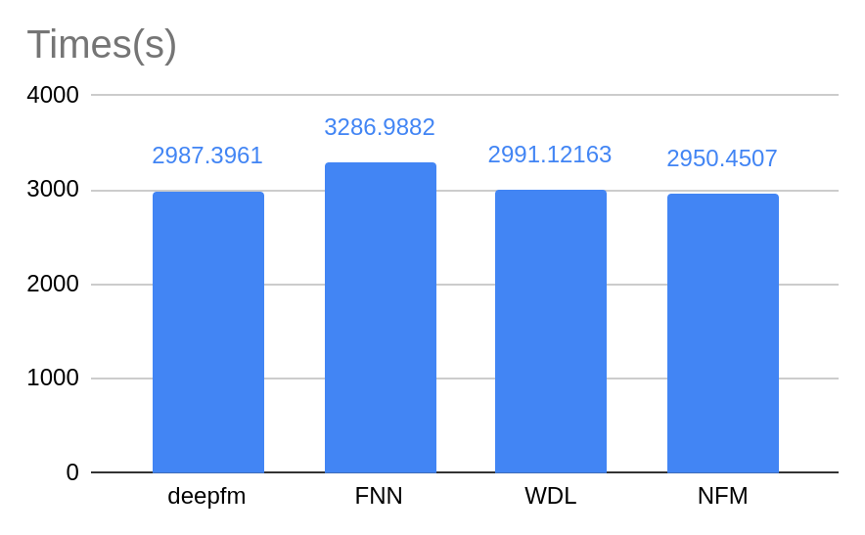
Times

Slide 12
Correct
Deepfm run the most efficiency than any others
Incorrect
DeepFM’s auc is lower than any others, we only use 1M rows data, far less than 45M rows data that paper uses
DeepFM’s auc only has 0.73, less than 0.8715 in paper, we should use more data to get more accuracy

Slide 13
Conclusion
Compare DeepFM and other ctr model, the evaluation result indicates that DeepFM is more effective than any state-of-the-art model.
Combine FM and DNN model to achive better performance
DeepFM learn both low-order and high-order feature
Without model pre-training
Without feature engineering

Slide 14
Conclusion
 | No-pretraining | High-order Feature | Low-order Feature | No Feature Engineering
FM | √ | × | √ | √
FNN | × | √ | × | √
PNN | √ | √ | × | √
Wide & Deep | √ | √ | √ | ×
DeepFM | √ | √ | √ | √

